Slide 1
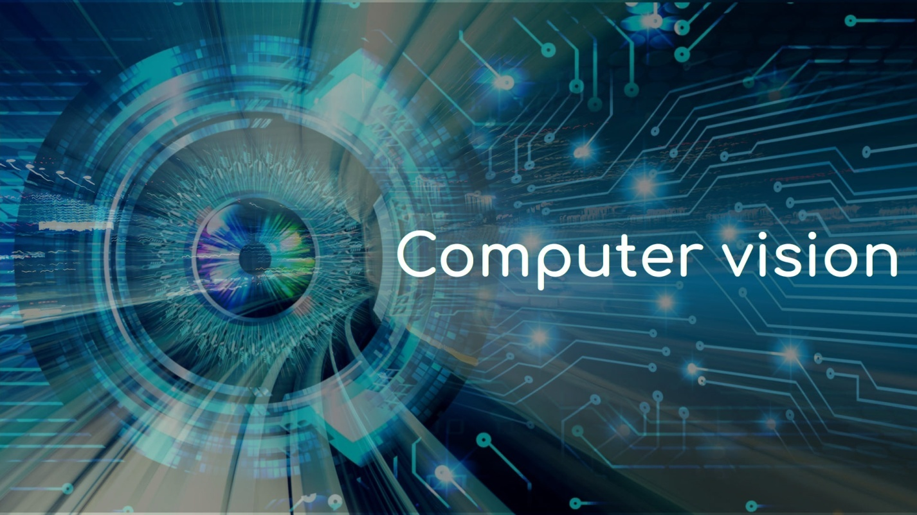

Computer Vision For Remote Connection
Team
Amita
Julie
Shailaja

Slide 2
Introduction
Bot is developed to Automate the process of connecting the Local machine to a Remote desktop and accessing apps like Web browser, Notepad and Calculator to extract data and storing the same on the Local machine
The Process is automated right from connecting to the remote desktop to displaying the results on the Local machine.
Bot is using Computer Vision Framework of UiPath to do the same.

Slide 3
Why CV?
AI Computer Vision uses Neural network with a combination of OCR and text fuzzy matching with a multi anchoring system.
Automation beyond selectors - Robots recognize and interact with more on-screen fields and components
Reliable on VDIs and desktops - Relieves issues with failure-prone image automation techniques and with selector-based targeting on desktops
Broad range of interface types - Includes VDI environments (Citrix, VMWare, Microsoft RDP, VNC, and others for desktop and web applications
Cross-platform capabilities - Supports automation on Windows, Linux, Android, and other operating systems
Dynamic UI elements -Enables automations that include drop-down and checkbox elements

Slide 4
Features
CV Activities
CV Screen Scope
CV Type Into
CV Get Text
CV Extract Table
CV Element Exists
CV Checkbox
CV Dropdown Select
Remote Connection
VNC Viewer
VNC server
Robotic Enterprise Framework

Slide 5
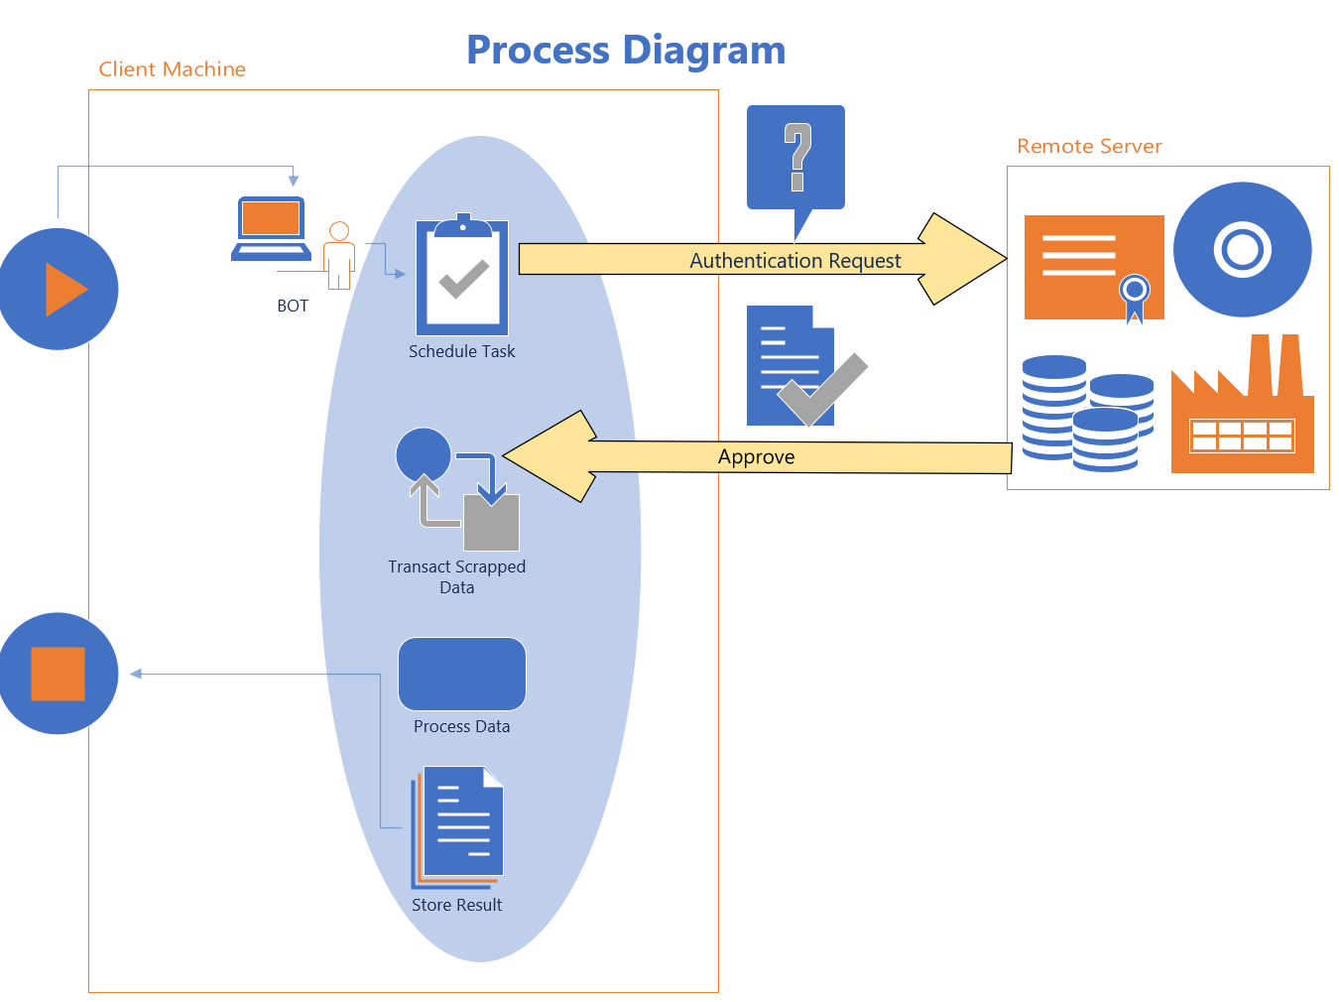
Process Flow
Sending Authentication Request to the Remote Machine for Server Connectivity.
Authentication Request Approved.
Starts Scraping Desktop\Web application based on the requirement.`
Scrapped data processes.
Processed data stored into the local machine.

Slide 6
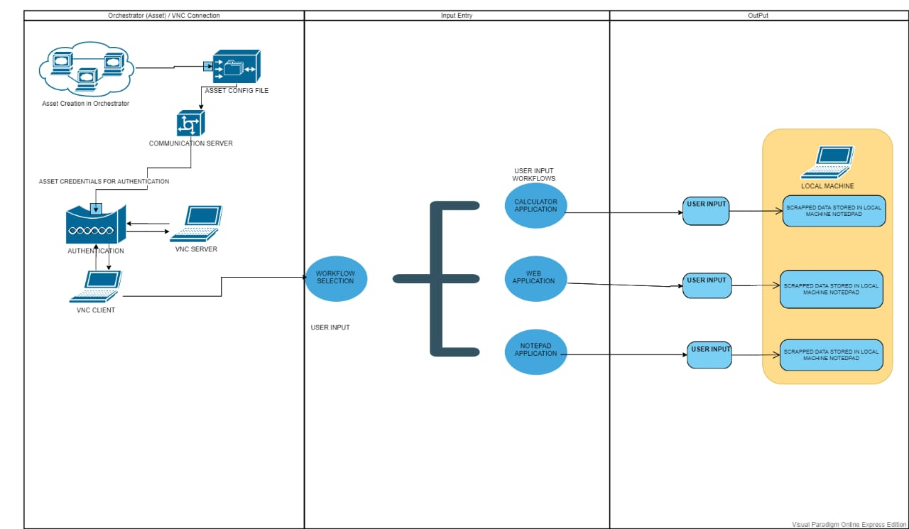
Detailed Project Flow
Intialize the Config with Asset Names of VNC Client And Server and Inputs for each Application
Get Credentials from Orchestrator
Open the VNC Client in Local Machine and sending Authentication request to server for connection.
Remote Machine screen will be displayed in Local Machine
Open Calculator App and enter Input and extract the Result
Open Notepad and enter Input file Name and Extract the Data
Open Web browser and enter search input and Extract the Result
Close the Remote Connection

Slide 7
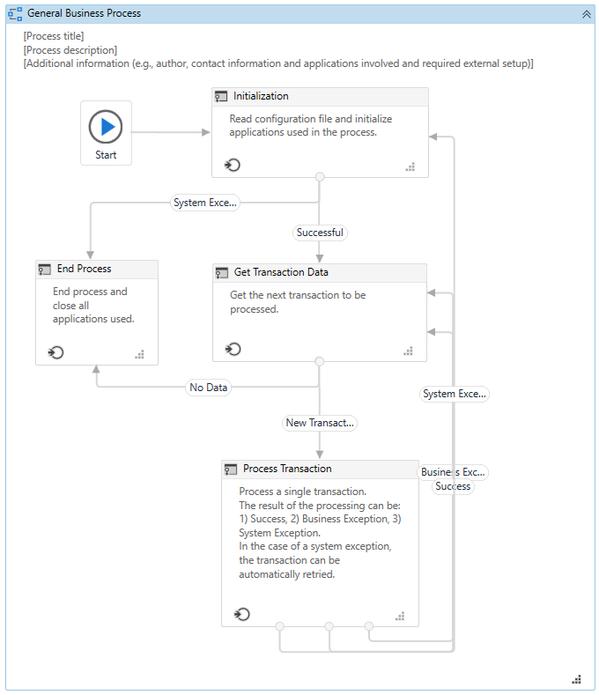
Coding Architecture

Slide 8
Value Added Benefits
Bot will automate the process of connecting to the Remote desktop and extracting the data using Apps from the desktop to display on the Local machine.
This utility can be used as a part of a larger system where automation for VDI is required.
Automation Time for the Bot
Total Time: 3:59
Time between each Transaction: 1:05

Slide 9
Q & A

